Slide 1
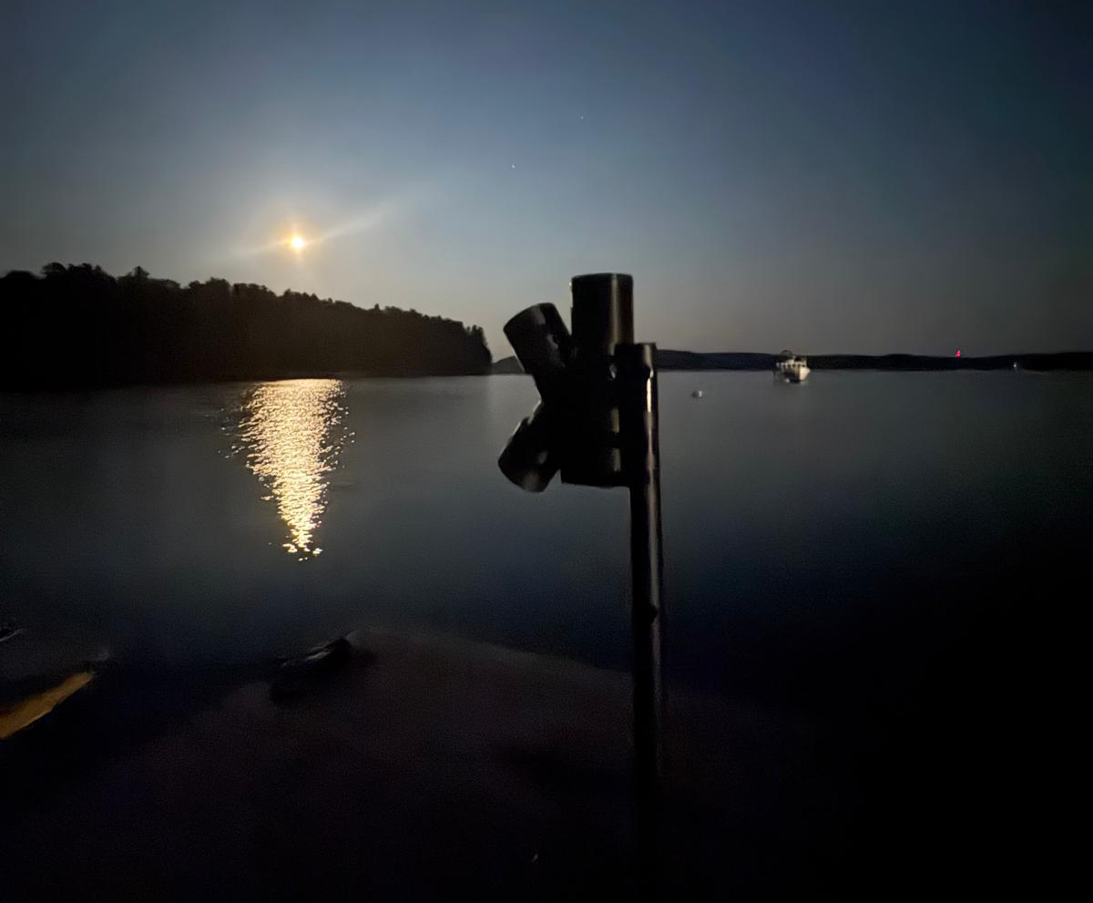
mySAS
Make-Your-own Spectral Acquisition System
Olivia Cronin-Golomb

Slide 2
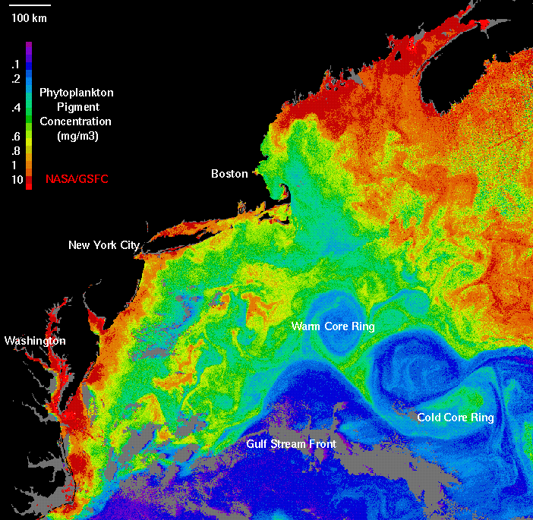
Why Measure Apparent Optical Properties
AOPs (Ed, Lt, Li) describe how light interacts with the water surface
From AOPs, we derive IOPs:
• Phytoplankton absorption
• CDOM absorption
• Particle scattering
In situ AOPs are needed for interpreting and validating remote sensing observations
NASA Ocean Color, SeaWIFS

Slide 3
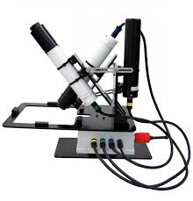
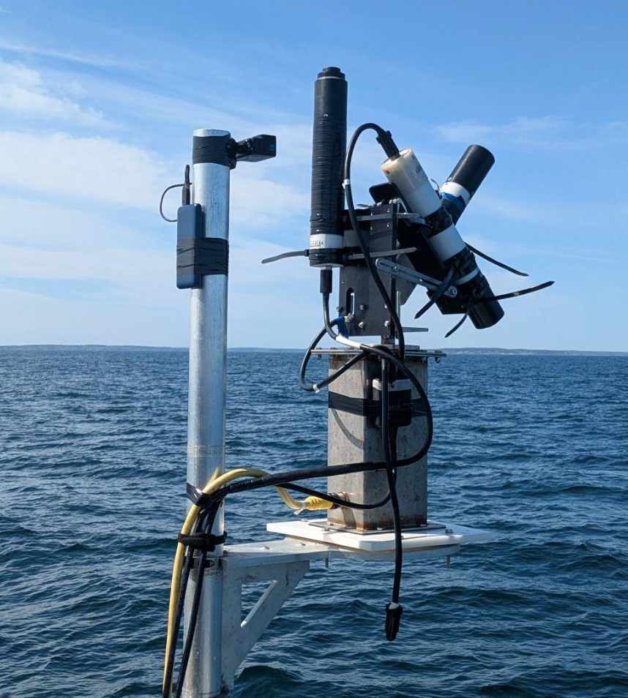
Why Build Custom Sensors?
Why Build Custom Sensors?
HyperSAS: Commercial system using Seabird OCRs • Discontinued and costly (~$60–100k)
pySAS: Open-source alternative using Seabird OCRs + modular electronics • Lower cost (~$3–5k) but still reliant on proprietary sensors
mySAS: Ultra-low-cost build (~$150) using off-the-shelf components (Arduino + Adafruit) • Portable, customizable, and broader access
SeaBird Scientific

Slide 4
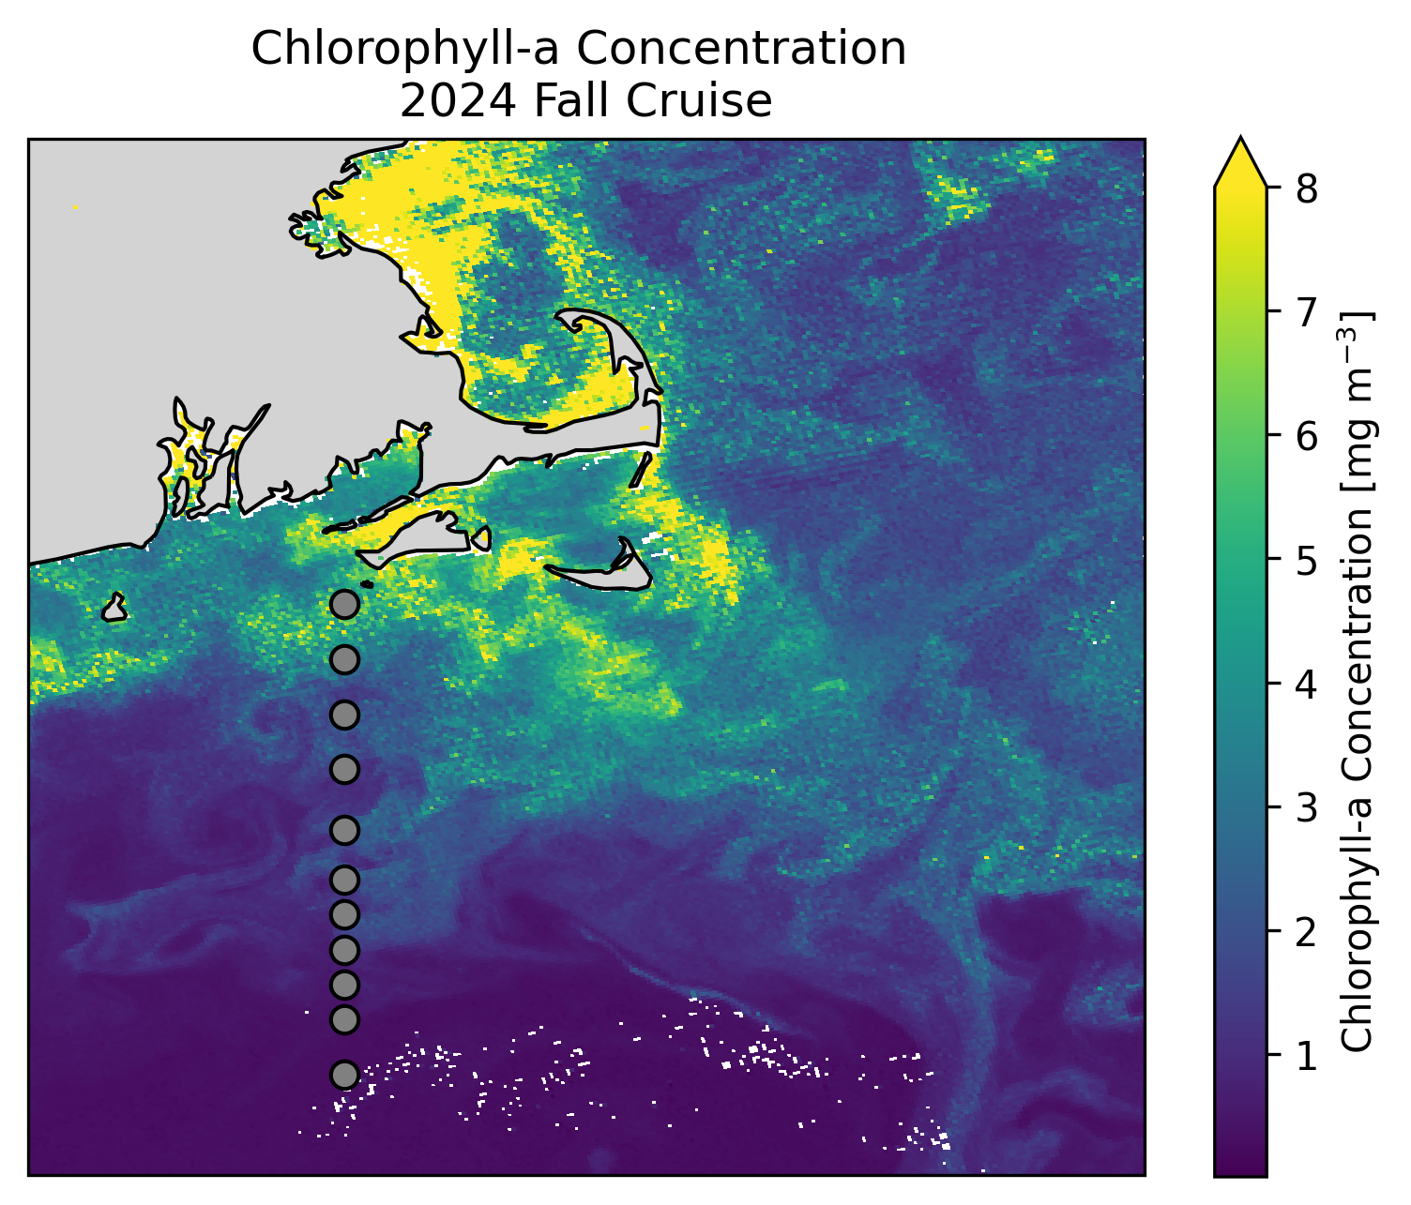
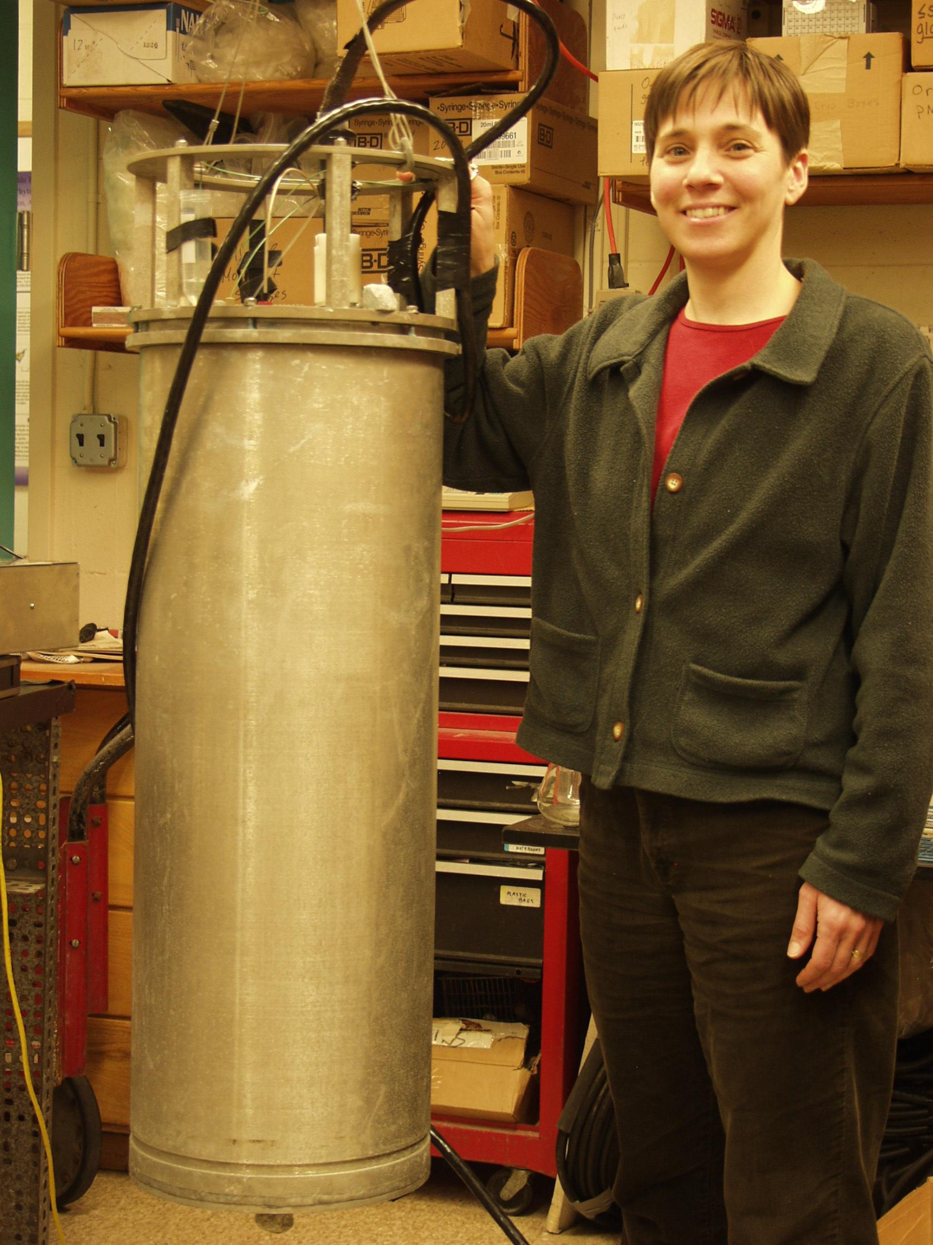
Inspiration

Slide 5
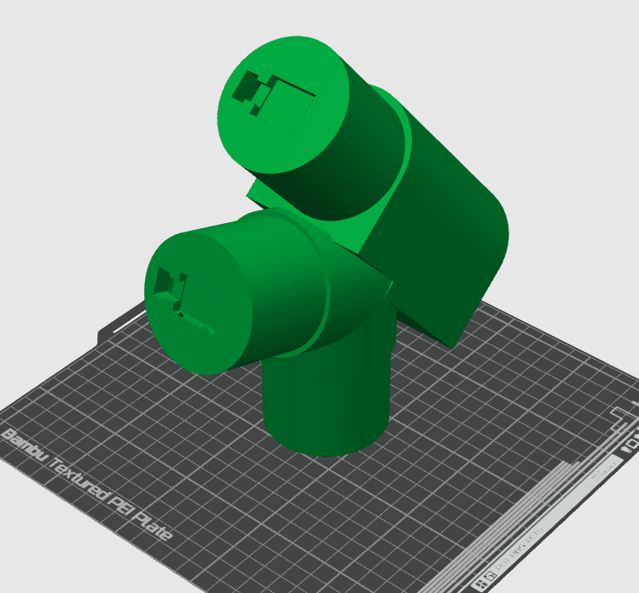
Casing - Mount

Slide 6
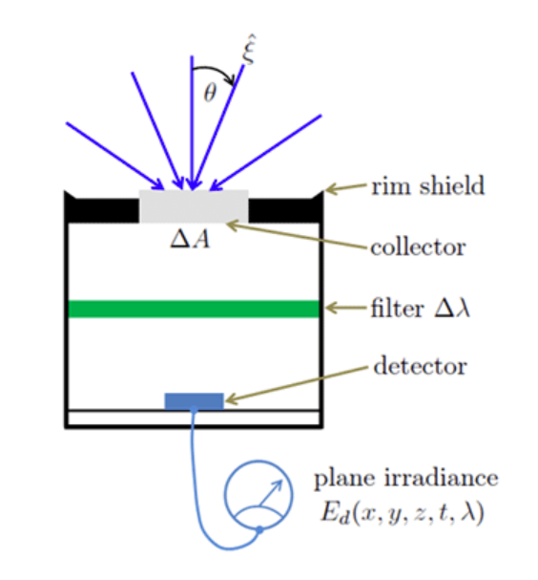
Irradiance Sensor (Ed)
Measures downwelling light from the full sky hemisphere
Cosine-weighted detector surface (accounts for incident angle)
Integrates both direct and diffuse light
Units: μW/cm²/nm
Ocean Optics Web Book
Notes:
The light from an entire hemisphere of directions can reach the detector. When pointed “straight up” it measures the spectral downwelling plane irradiance
The cosine law for irradiance is simply the statement that a collimated beam of light intercepting a plane surface produces an irradiance that is proportional to the cosine of the angle between the incident directions and the normal to the collector surface.
Since the instrument of Fig. 3 collects light traveling in all downward directions, but with detector’s surface area weighted by the cosine of the light’s incident angle , the instrument is in essence integrating over all incident directions in the hemisphere seen by the sensor.

Slide 7
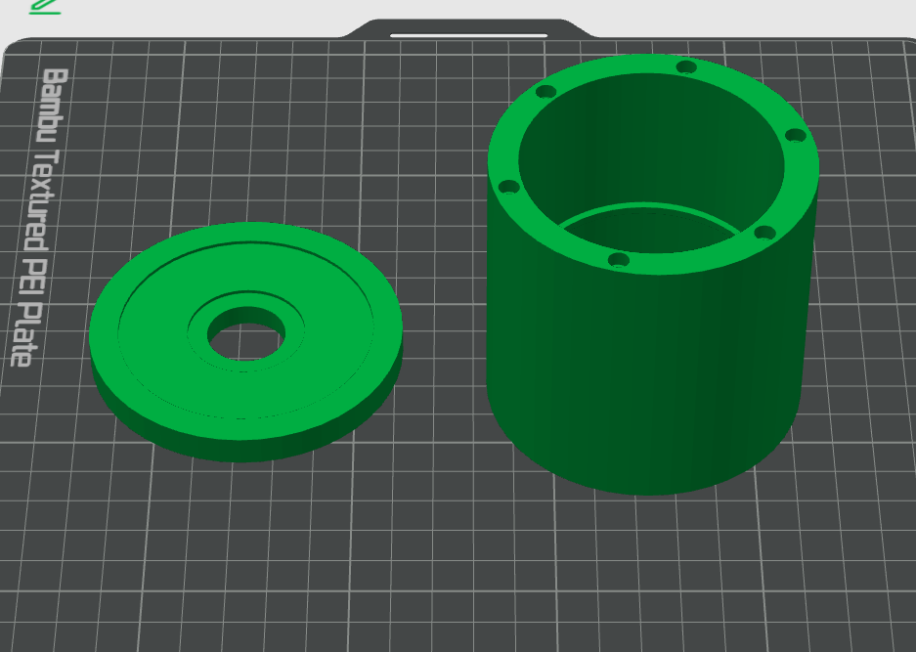
Casing - Irradiance Sensor
Design choices:
Magnetic
No supports needed
Lip so you don’t overshoot the connection
PTFE teflon on top
Notes:
Made location of sensor too short so made the pinhole very big to account for it
Orginal design had sensor shorter than the radiance tubes to had to raise it up

Slide 8
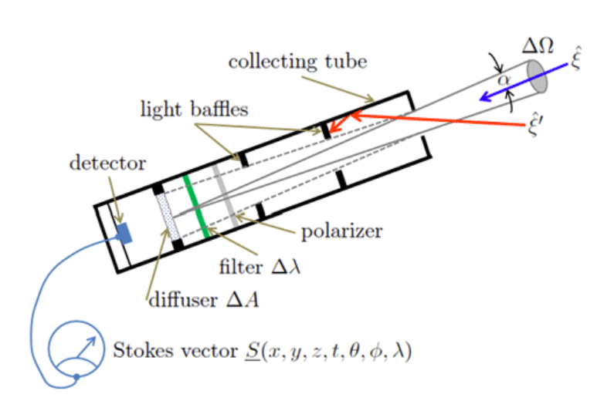
Radiance Sensor (Li and Lt)
Li: sky radiance ; Lt: water-leaving radiance
Light enters through a circular aperture and passes through baffle. The detector measures light from that solid angle (defined FOV)
Units: μW/cm²/sr/nm
Ocean Optics Web Book
Notes:
A circular hole at one end of the housing or collecting tube and a system of internal light baﬄes allows the detection of light that enters the hole only at angles of alpha or less (alpha is ﬁeld of view (FOV) half angle)
The solid angle seen by the detector

Slide 9
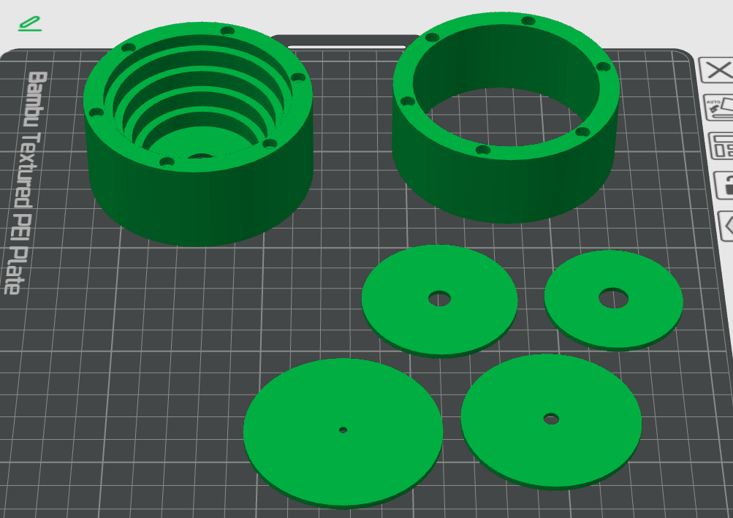
Casing - Gershun Tubes
Design choices:
Magnetic
No supports needed
Pitfall:
Superglue blooms when exposed to humidity and enclosed places.
10°
Θ
Notes:
Design choices:
Magnetic
No supports needed
FOV of 10deg
5 baffles
Redesign
Learned tinkercad - open source

Slide 10
Sensor Geometry & Rrs Calculation
Ed: points straight up and measures total downwelling irradiance
Lt: 40° off nadir and measures water-leaving radiance + surface-reflected sky light
Li: 40° above horizon and measures sky radiance for glint correction
To calculate Rrs: Rrs = (Lt – ρ · Li) / Ed ρ ≈ 0.028 for 40° viewing angle (Mobley, 1999)

Slide 11
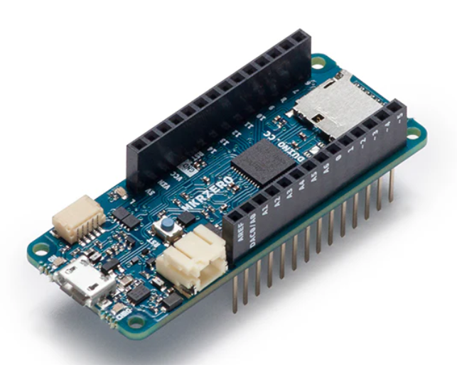
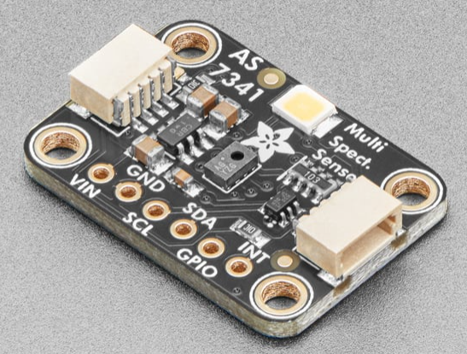
Hardware
Adafruit 10-Channel Light/Color Sensor
Arduino MKR ZERO

Slide 12
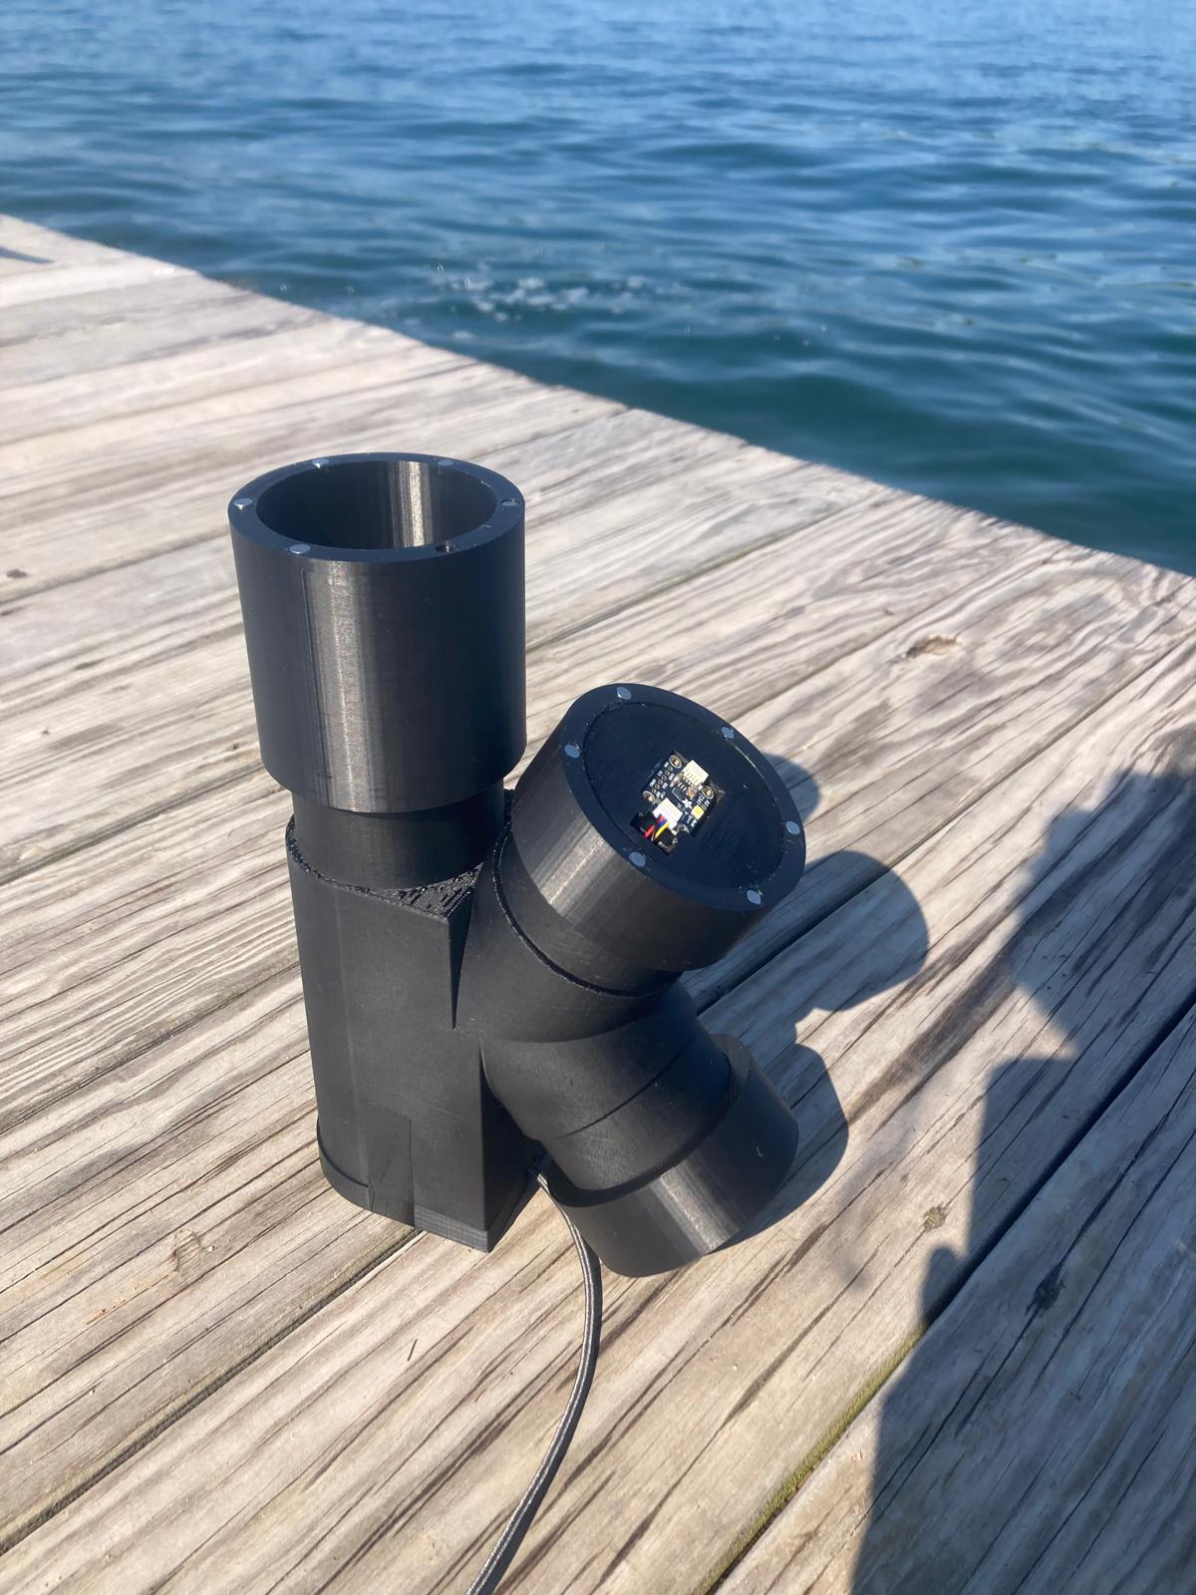
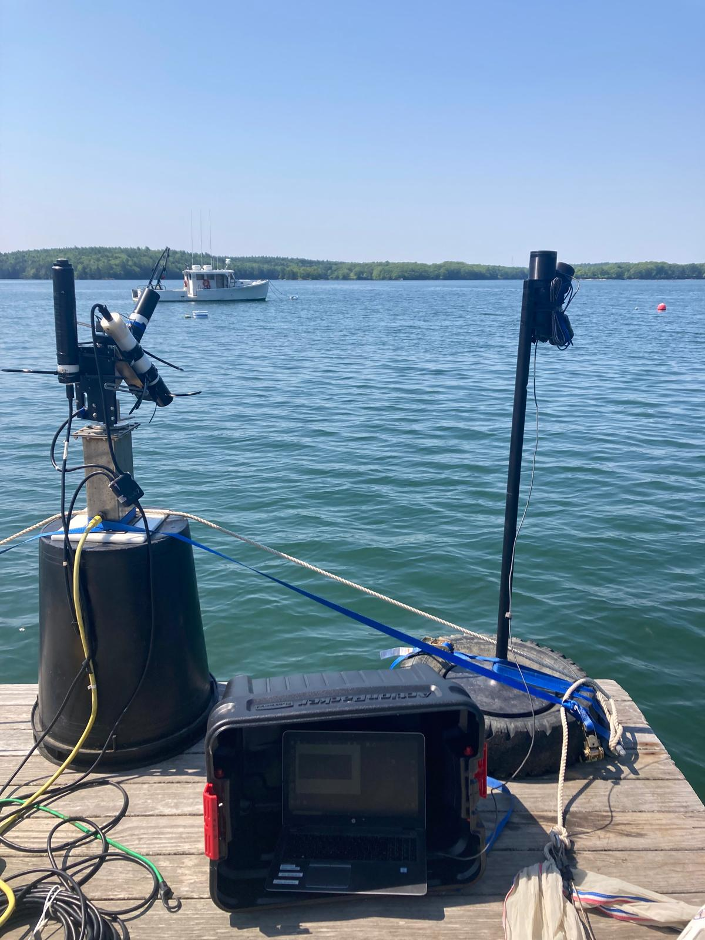
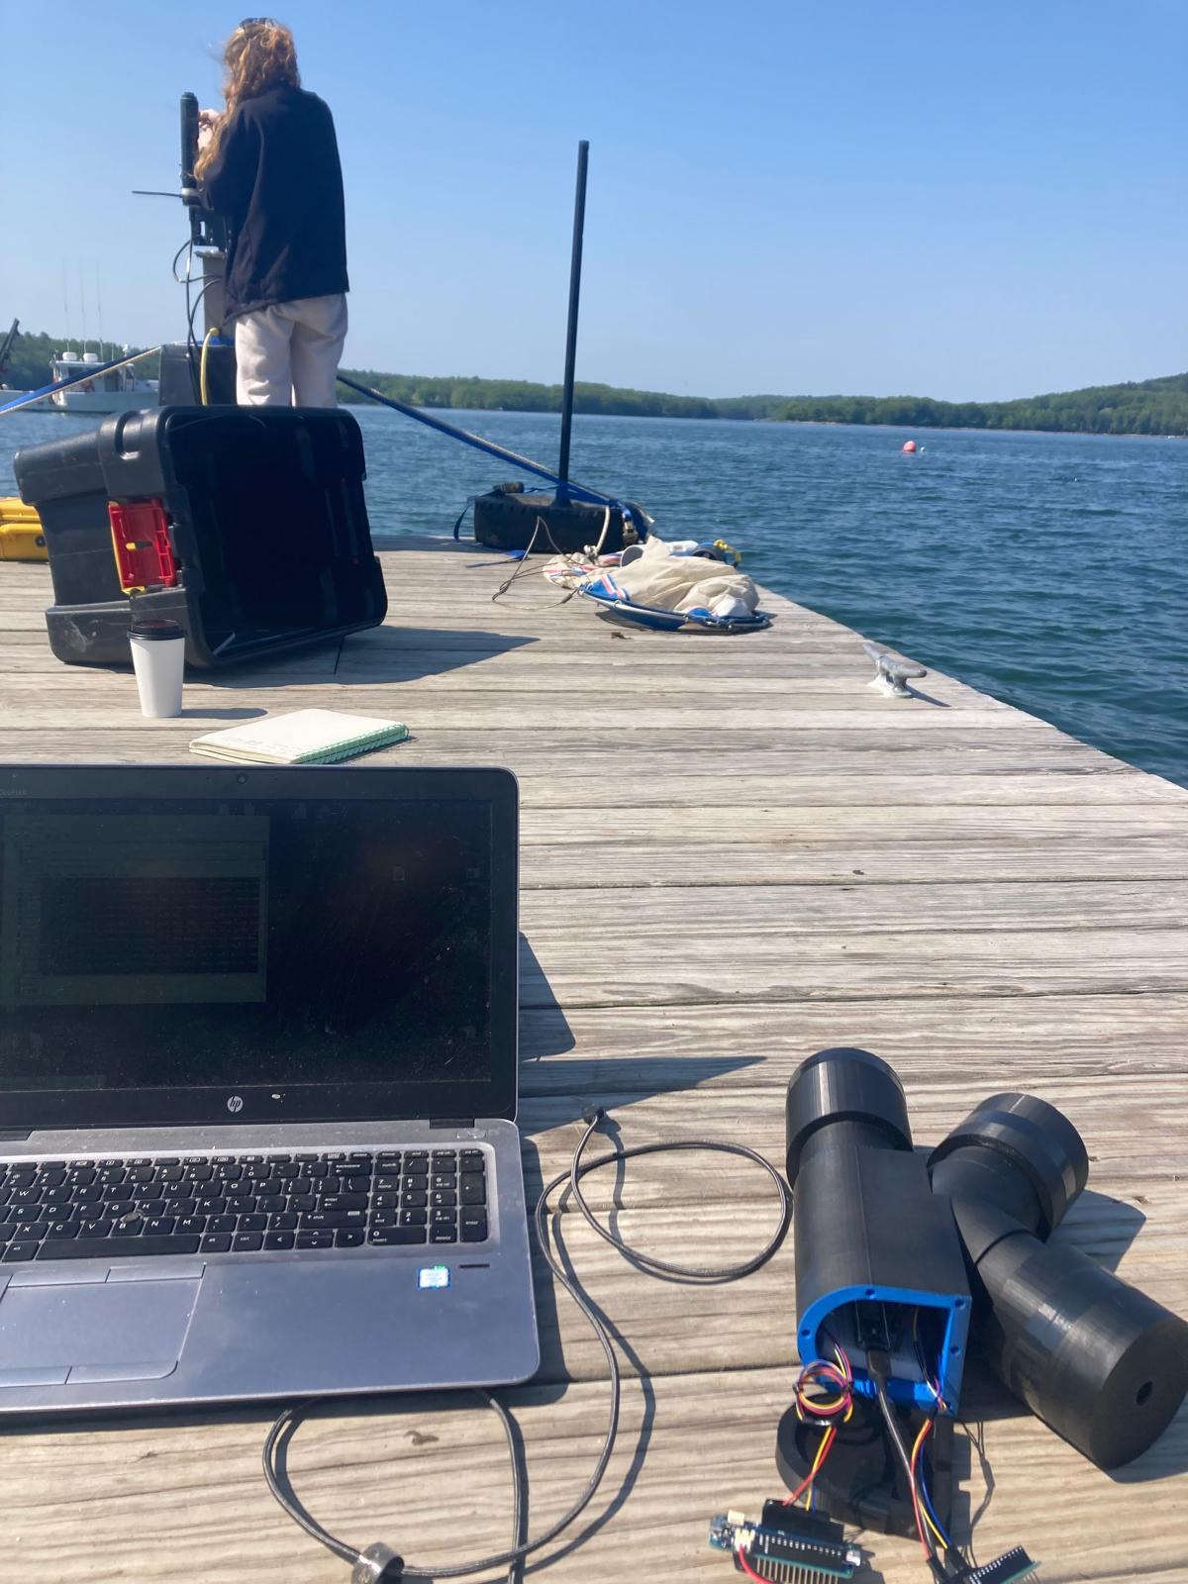
Deployment
Notes:
Innovative use of a hand sanitizing station pole

Slide 13
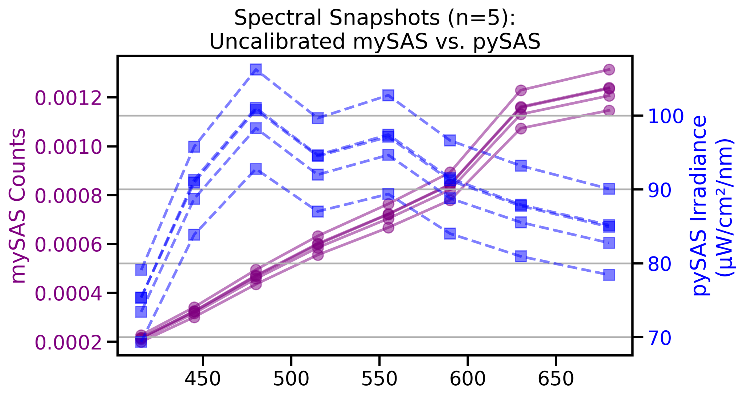
Irradiance Performance - Spectral
Notes:
uW/cm2/nm

Slide 14
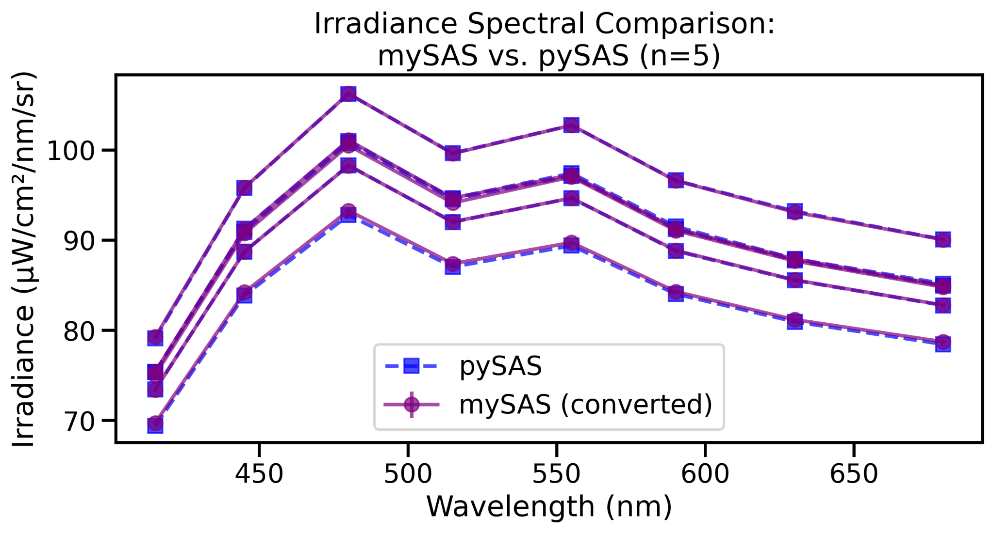
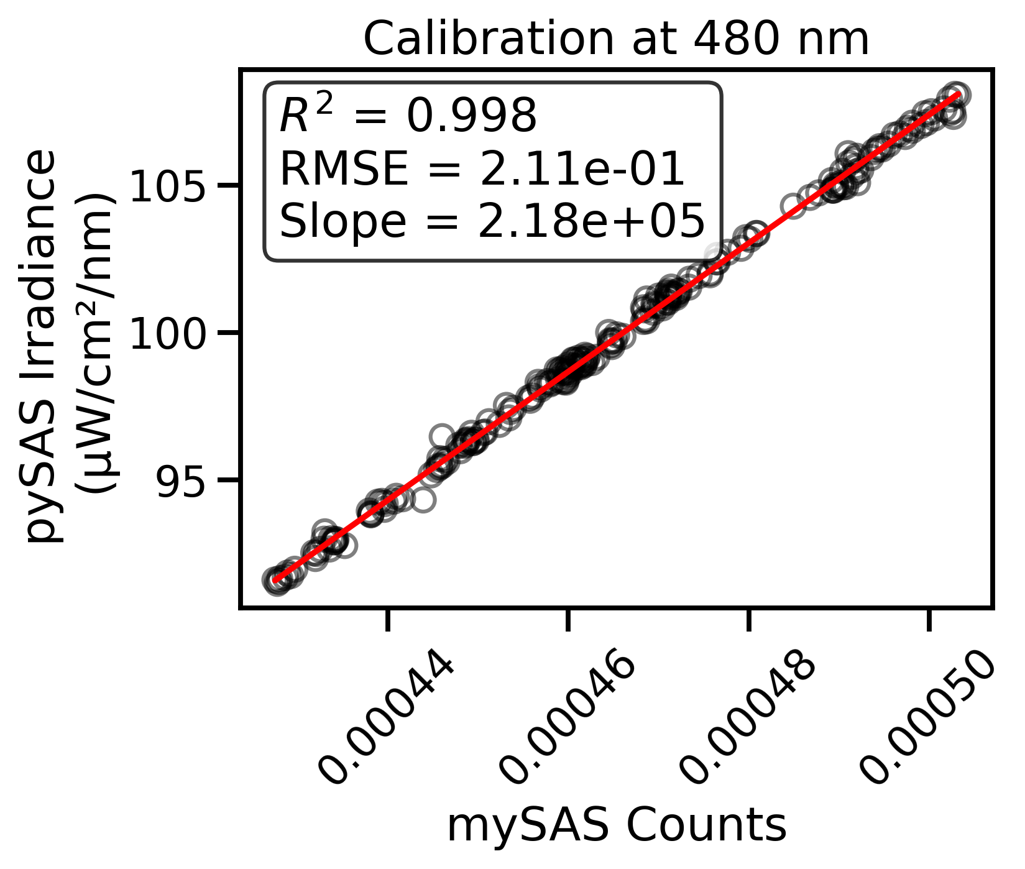
Irradiance pySAS to mySAS Conversion

Slide 15
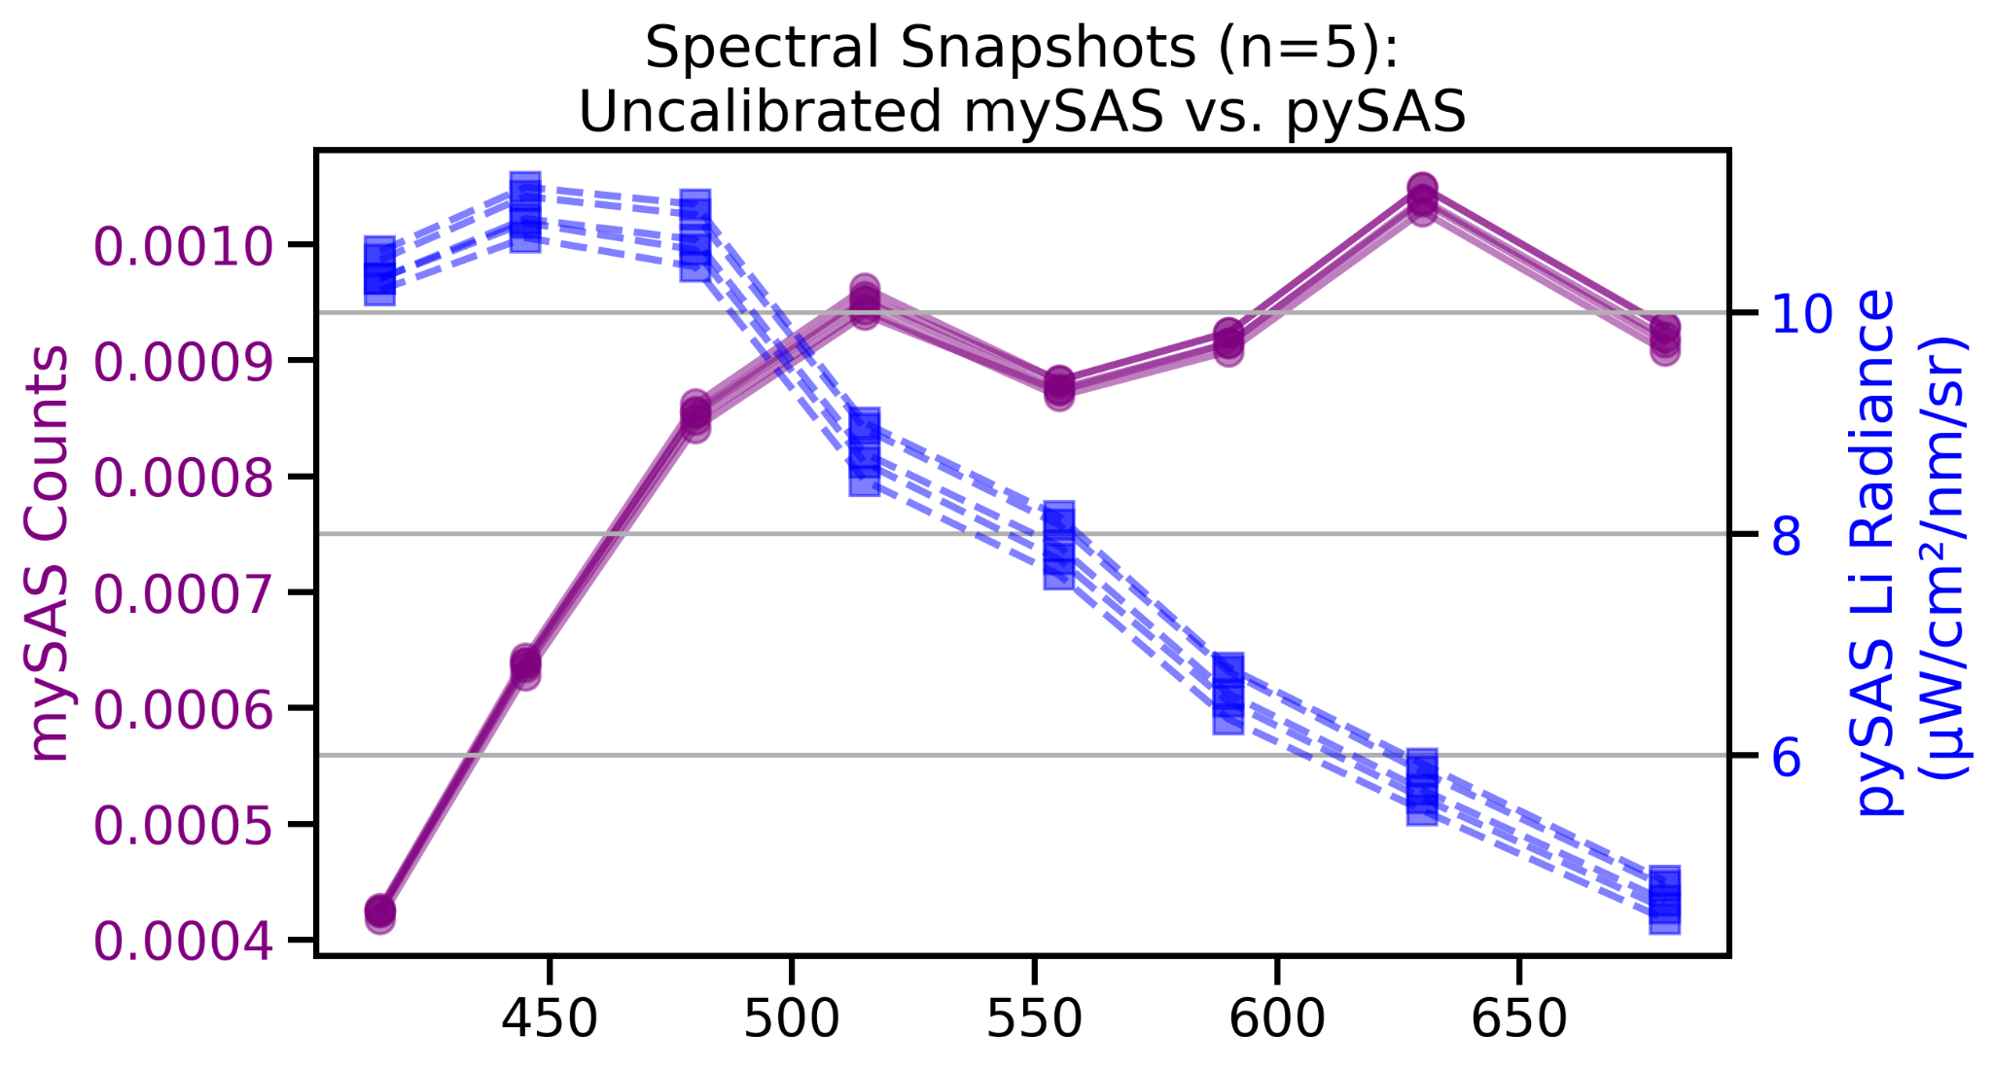
Li Radiance Performance - Spectral

Slide 16
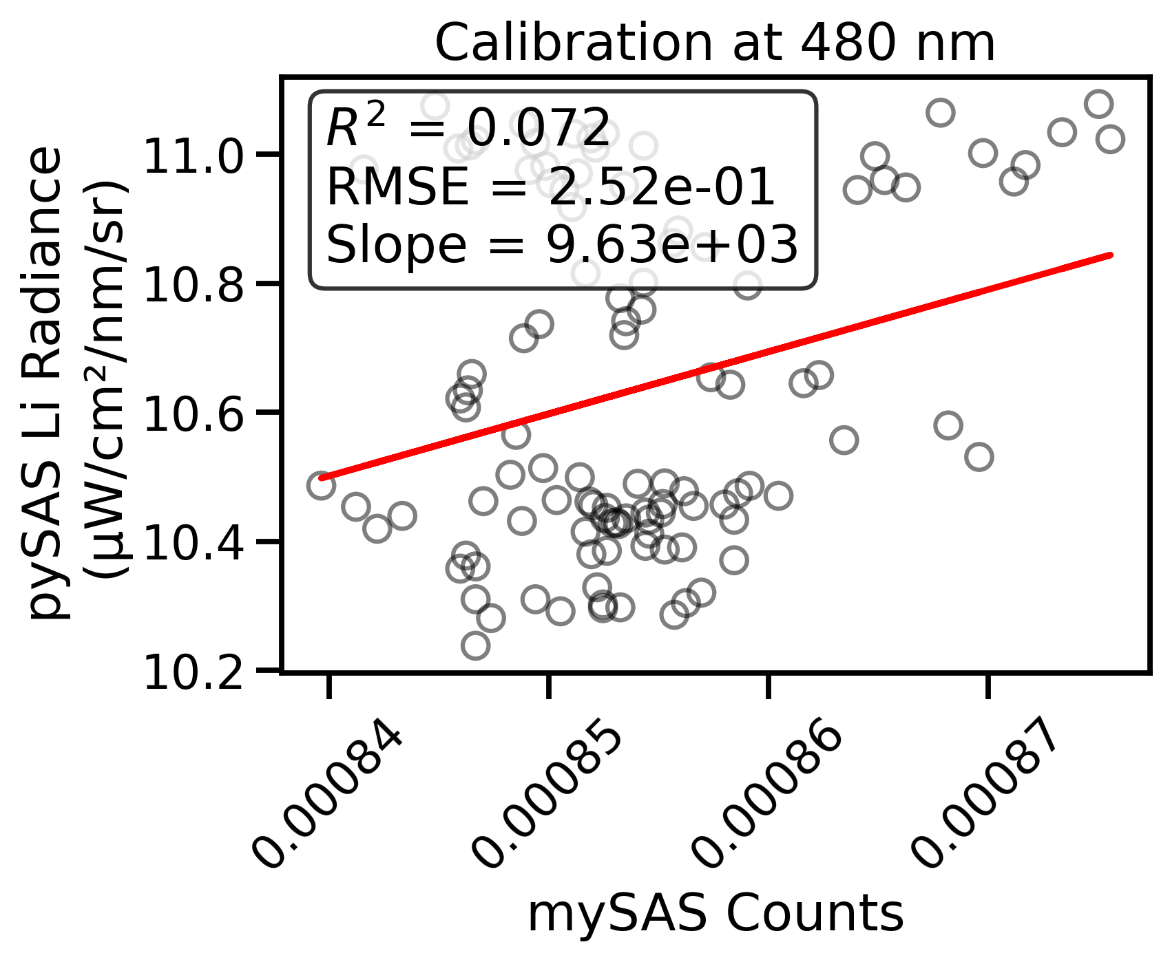
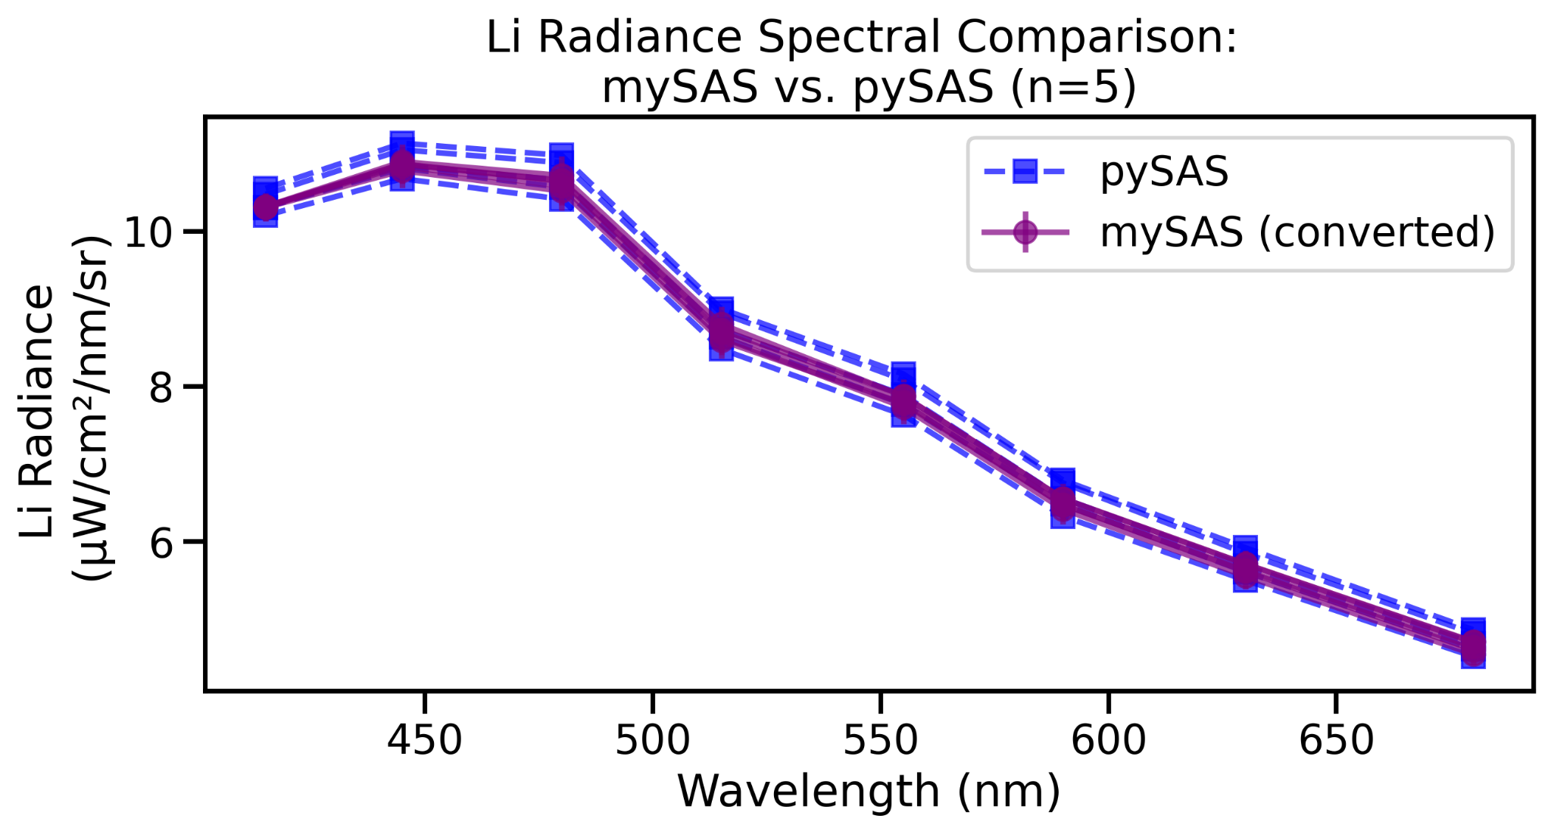
Li Radiance pySAS to mySAS Conversion
Notes:
Low R2 but the range of values was also low, hard to build a regression of that, but the visual fit is appealing

Slide 17
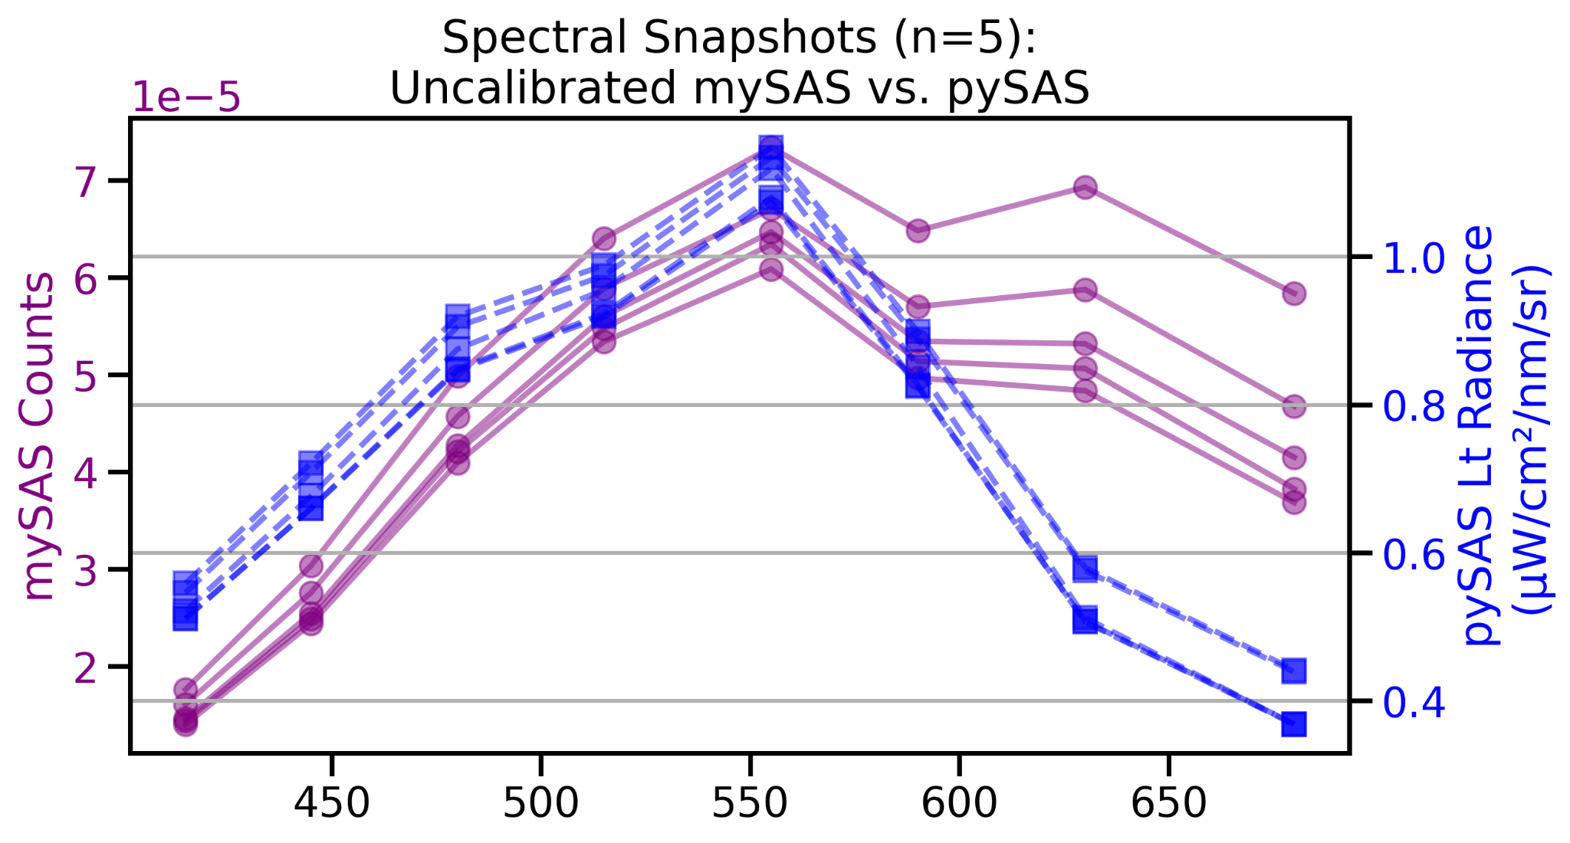
Lt Radiance Performance - Spectral
Notes:
Looks green even before correction

Slide 18
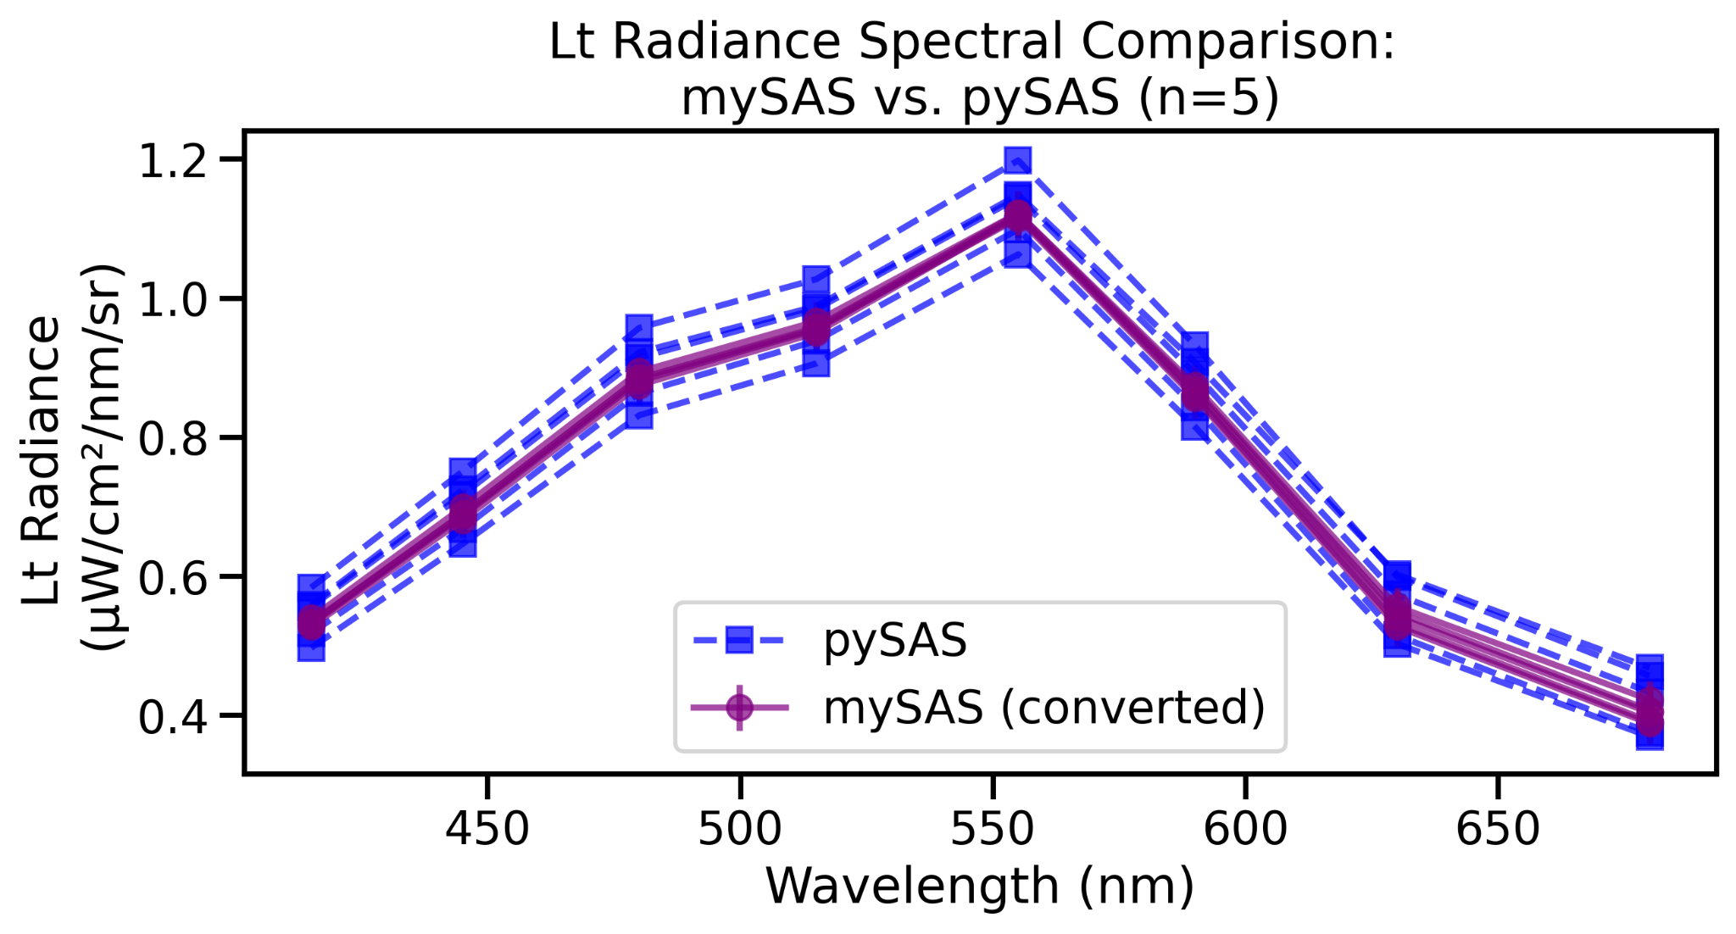
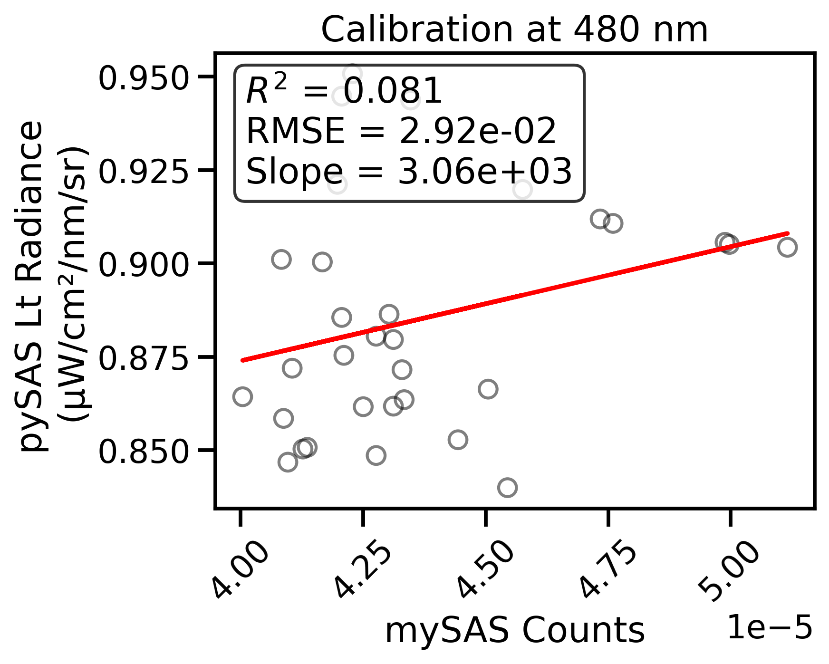
Lt Radiance pySAS to mySAS Conversion
Notes:
Also low range so low R2. need to sample for longer

Slide 19
Prototype I
Budget
Item | Number | Cost
Arduino MKR Zero | 3 | 93.6
Adafruit 10-Channel Light/Color Sensor | 3 | 47.85
Adafruit LiPo batteries | 3 | 37.5
SD Cards | 3 | 57.02
USB Cables | 3 | 18.98
3D Printing Filament | 1 | 14.76
Teflon | 1 | 15.96
QWIIC cables | 3 | 2.85
Extra wires | 1 | 9.99
Magnets / Spray Paint / Superglue / e-tape | 1 | 19.23
Total: $317.74 (without shipping)
Notes:
Preform to estimate costs

Slide 20
Prototype II
Budget
Item | Number | Cost
Arduino HUZZAH32 | 1 | 21.95
Adafruit 10-Channel Light/Color Sensor | 3 | 47.85
Adafruit tilt sensor | 1 | 4.95
Adafruit Multiplexer | 1 | 3.95
Adafruit LiPo batteries | 1 | 12.5
18% Gray Card | 1 | 10.49
USB Cables | 1 | 6.32
3D Printing Filament | 1 | 14.76
Teflon | 1 | 15.96
QWIIC cables | 4 | 3.8
Magnets / Superglue / e-tape | 1 | 11.24
Total Prototype I: $317.74 (without shipping)
Total Prototype II: $153.77 (without shipping)

Slide 21
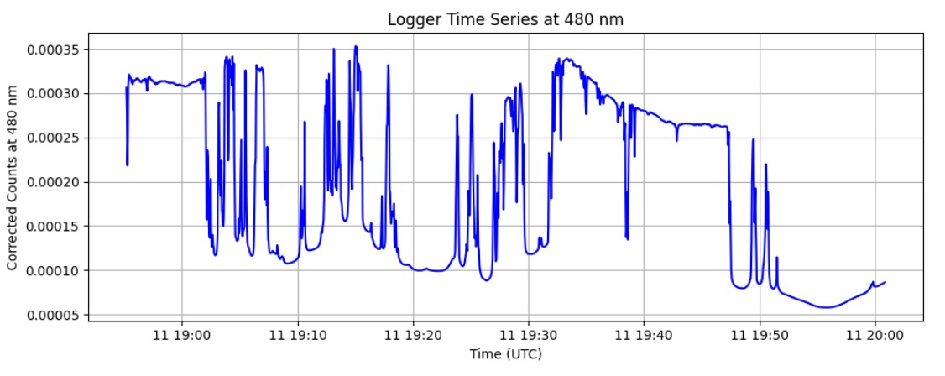
Sources of Error and Mistakes Made
Errors
Superglue bloomed inside the tube, leaving a white residue
Irradiance sensor had a large gap between the cosine collector and detector
Only ~40 minutes of sampling, during high wind and waves
mySAS angle shifted due to wind
Mistakes
Ordered the wrong SD cards twice; ended up using serial logging
Amazon LiPo batteries were incompatible
First 3D prints had support structures blocking the pinholes, requiring a redesign
Had variable gain for my first deployment which caused a lot of noise

Slide 22
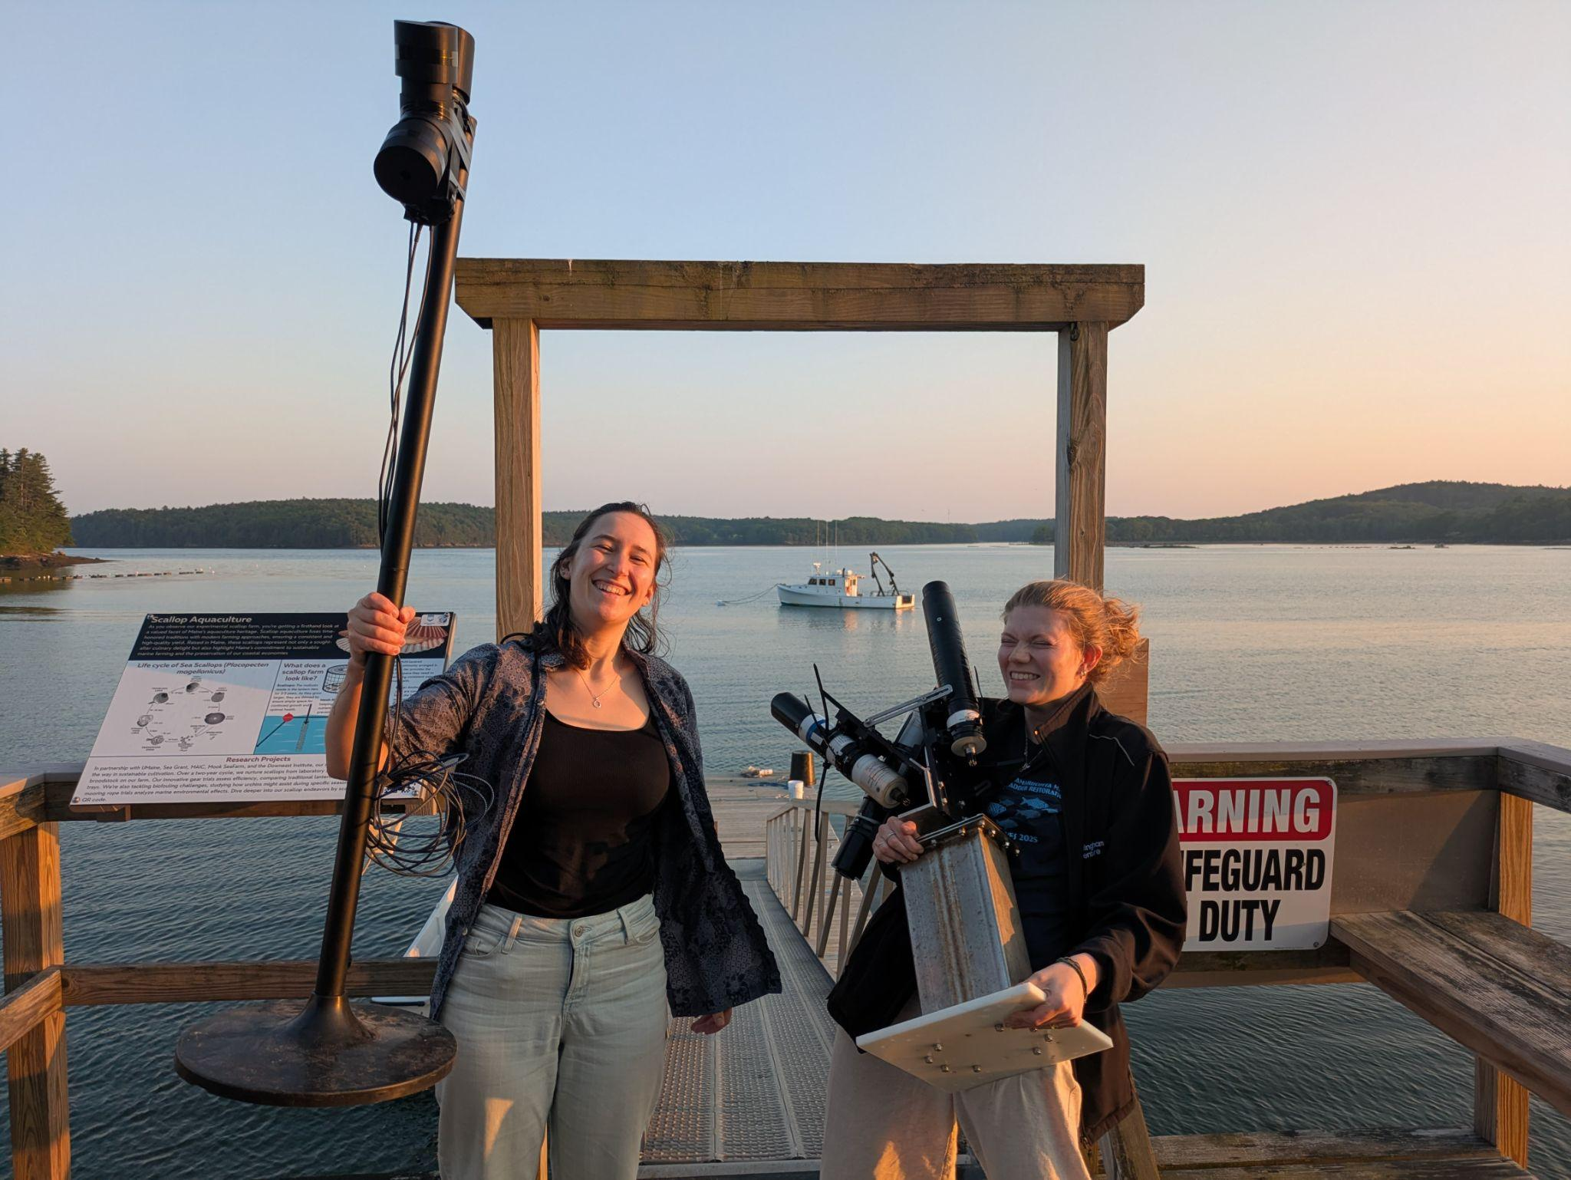
Conclusions
mySAS showed strong agreement with the commercial pySAS, especially for irradiance
Low-cost, portable, and easy to modify with off-the-shelf parts
Flexible platform for adding features like Bluetooth, RTC, or more channels
Potential to reduce cost further by consolidating sensors
Well-suited for student projects, fieldwork, and open-source remote sensing

Slide 23
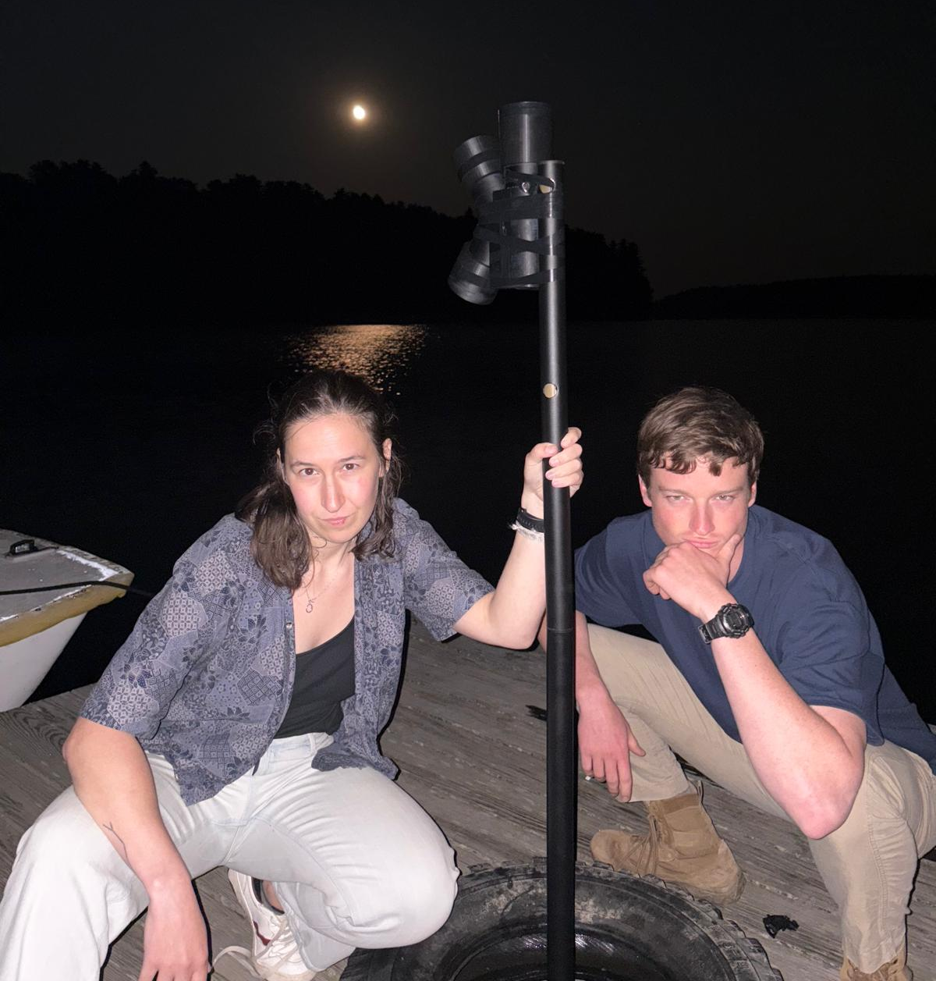
Next Steps
Convert to Rrs and compare to pySAS Rrs
Quantify uncertainty
Make it more affordable
Bring it out on the NES-LTER cruise track
Make GitHub repo to house the design and code
Write
Methods/white paper
Science outreach product

Slide 24
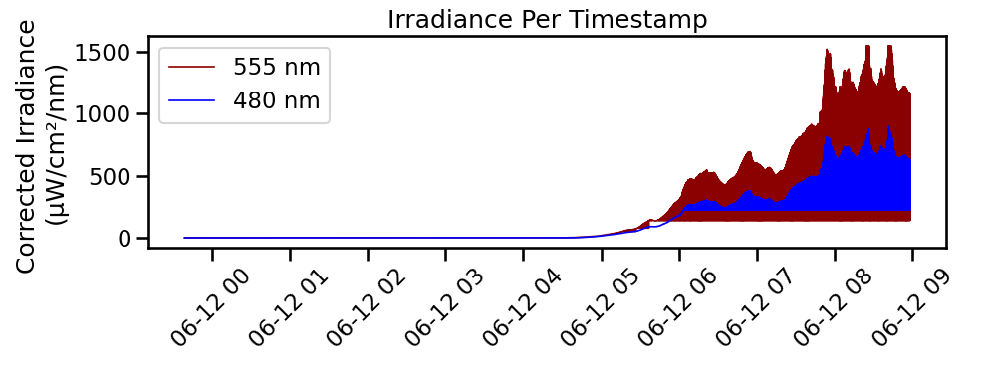
Moon Attempt

Slide 25
Next Steps
Hardware Improvements
Add more spectral channels (e.g., UV, NIR)
Enable WiFi communication with a mobile app, also can pull timestamps from that
Support Inlinino interfacing
Use a single data port for multiple sensors to simplify and reduce cost
Validate with open source HydroColor app instead of pySAS
Casing Improvements
Add internal slots to securely hold Arduino boards
Design side-opening access (instead of bottom) for easier maintenance
Include a locking mechanism for sensor caps
Extend the irradiance sensor stem for improved angular response
Reduce overall size to enhance portability and minimize plastic use
Add a gimbal to keep it upright on a ship
Make it waterproof - resin/heatgun, lens

Slide 26
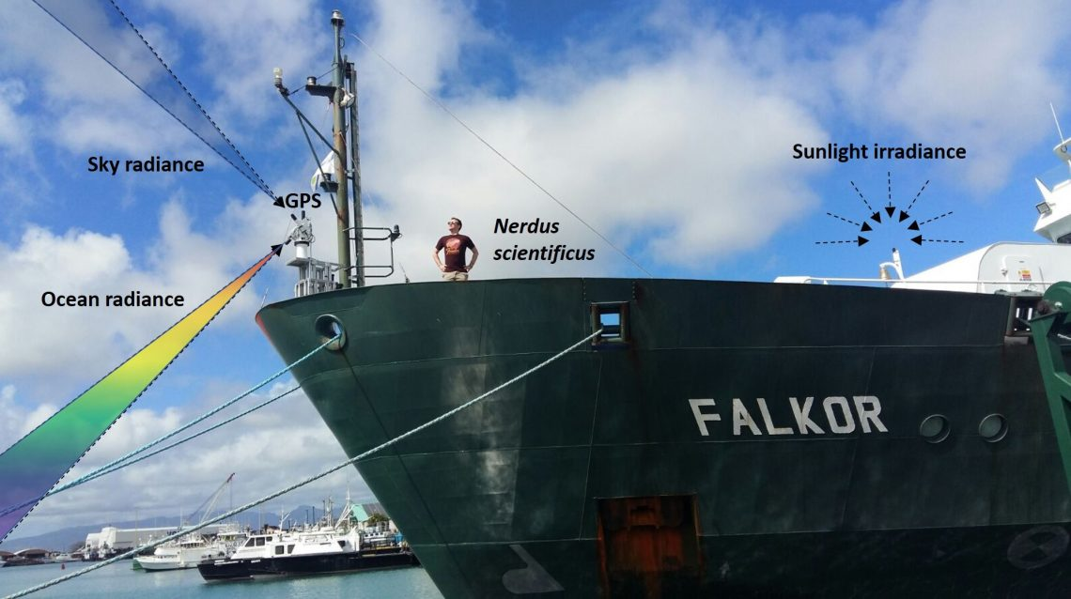
Questions?? Concerns??
NASA PACE Gallery

Slide 27
Supplemental

Slide 28
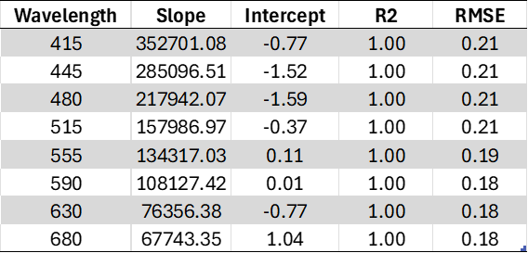
ES Conversion Stats

Slide 29
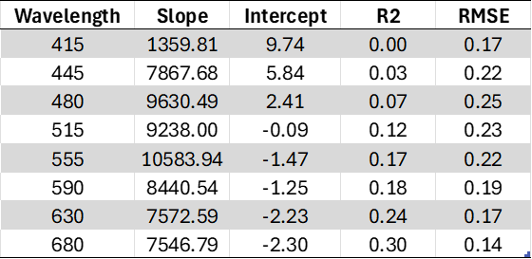
Li Conversion Stats

Slide 30
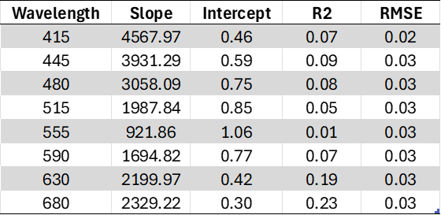
Lt Conversion Stats

Slide 31
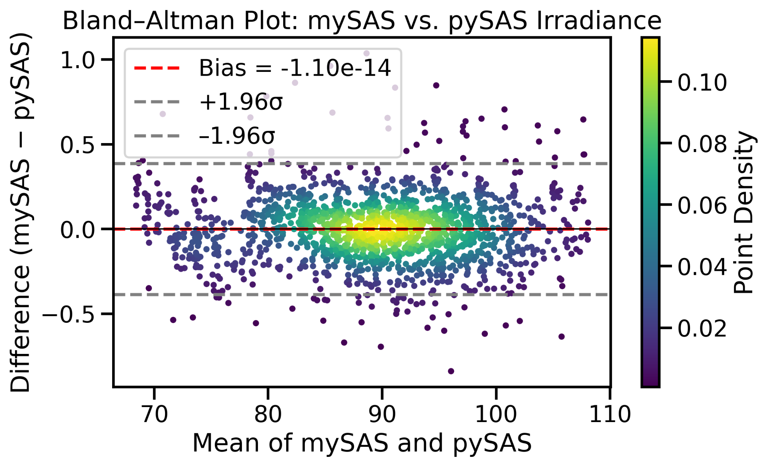
Irradiance Evaluation

Slide 32
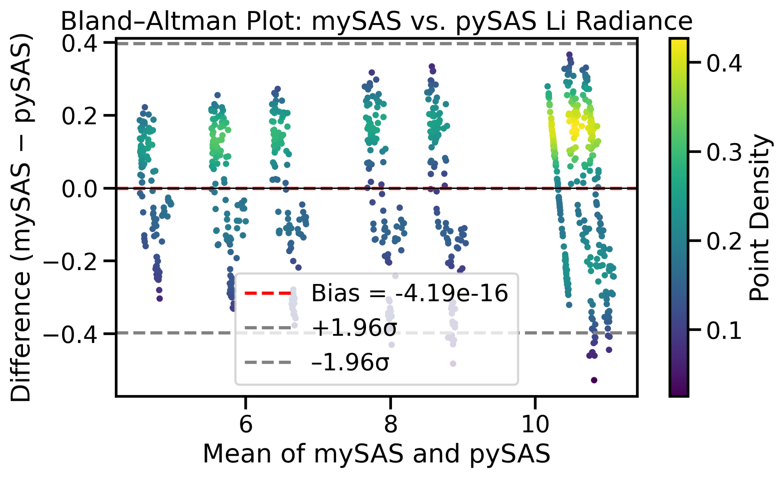
Li Radiance Evaluation

Slide 33
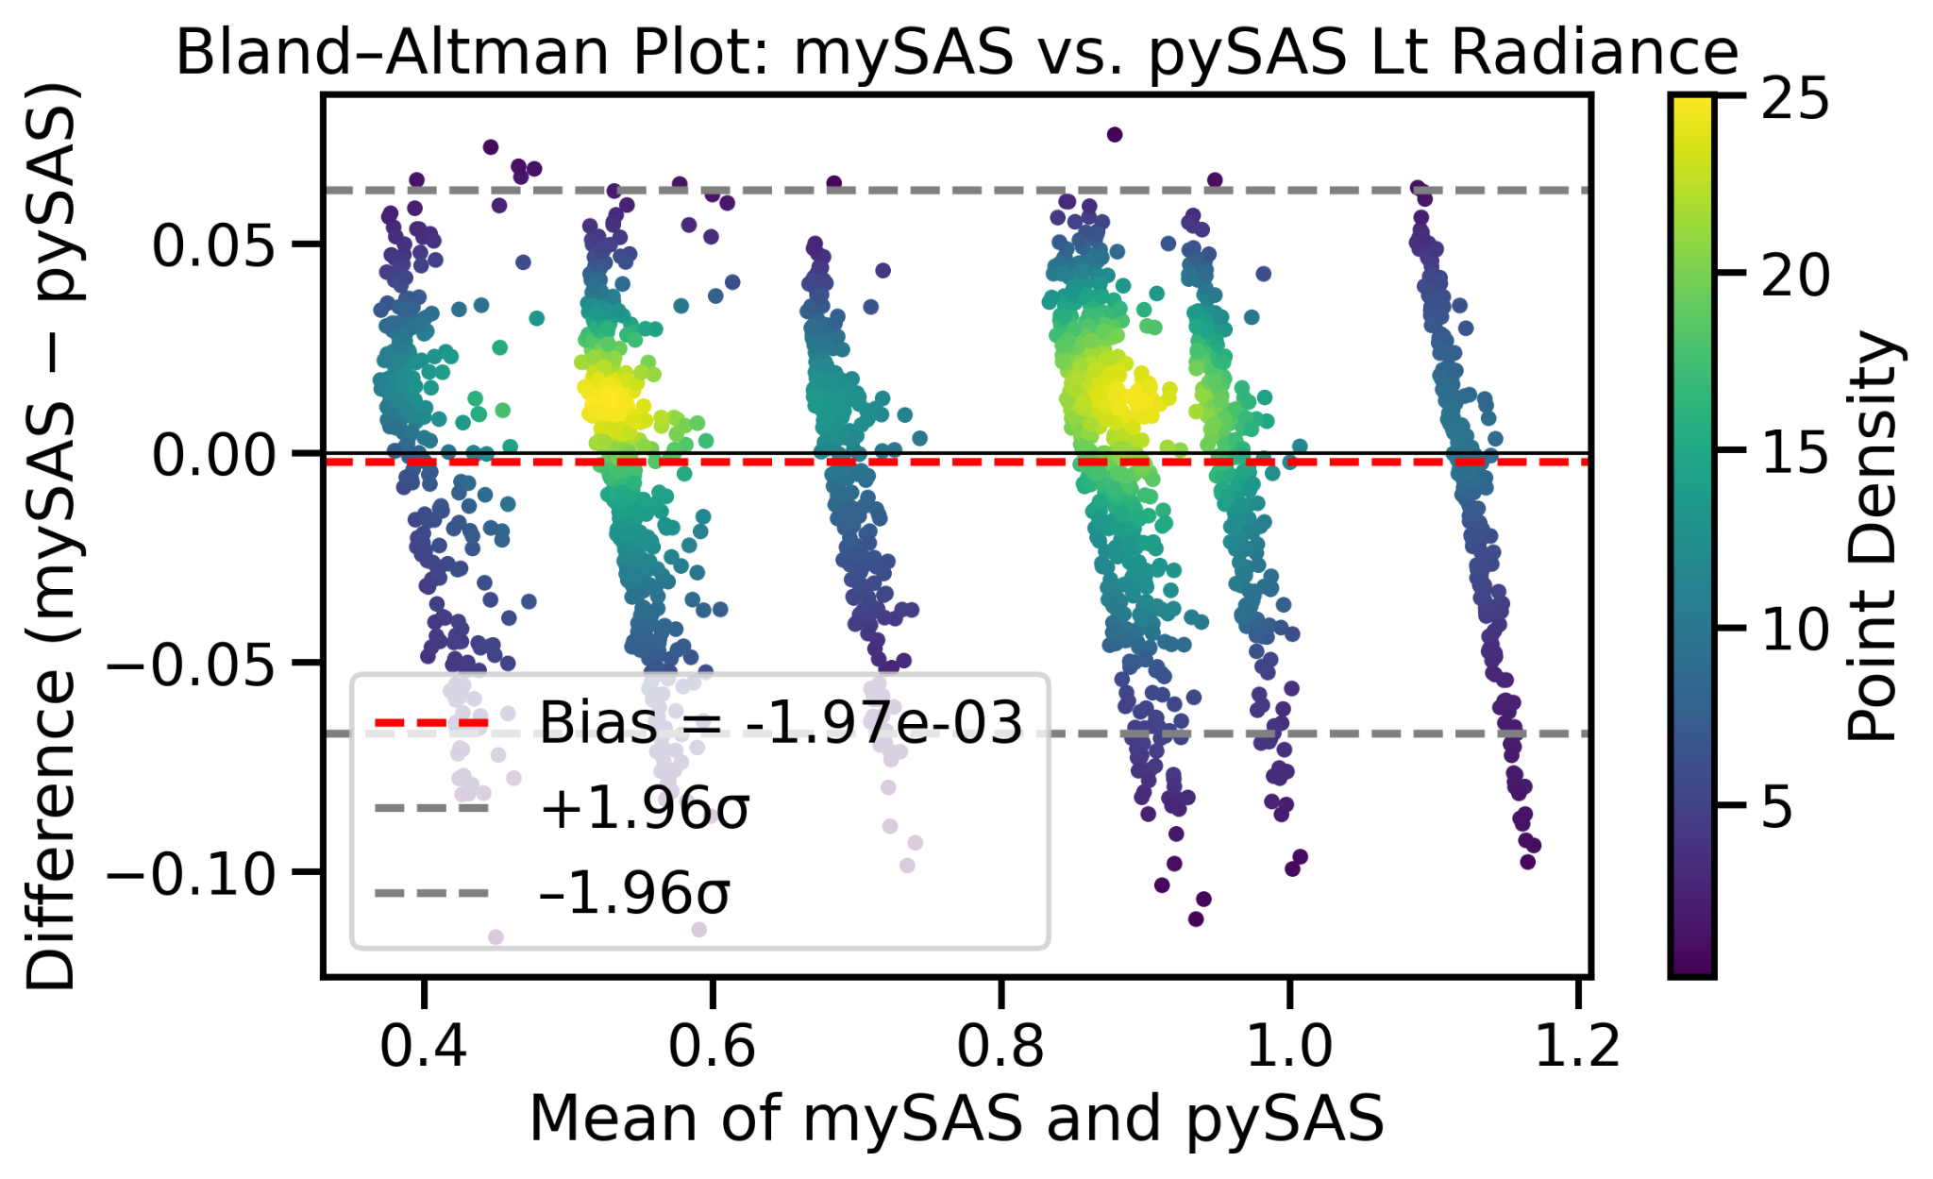
Lu Radiance Evaluation

Slide 34
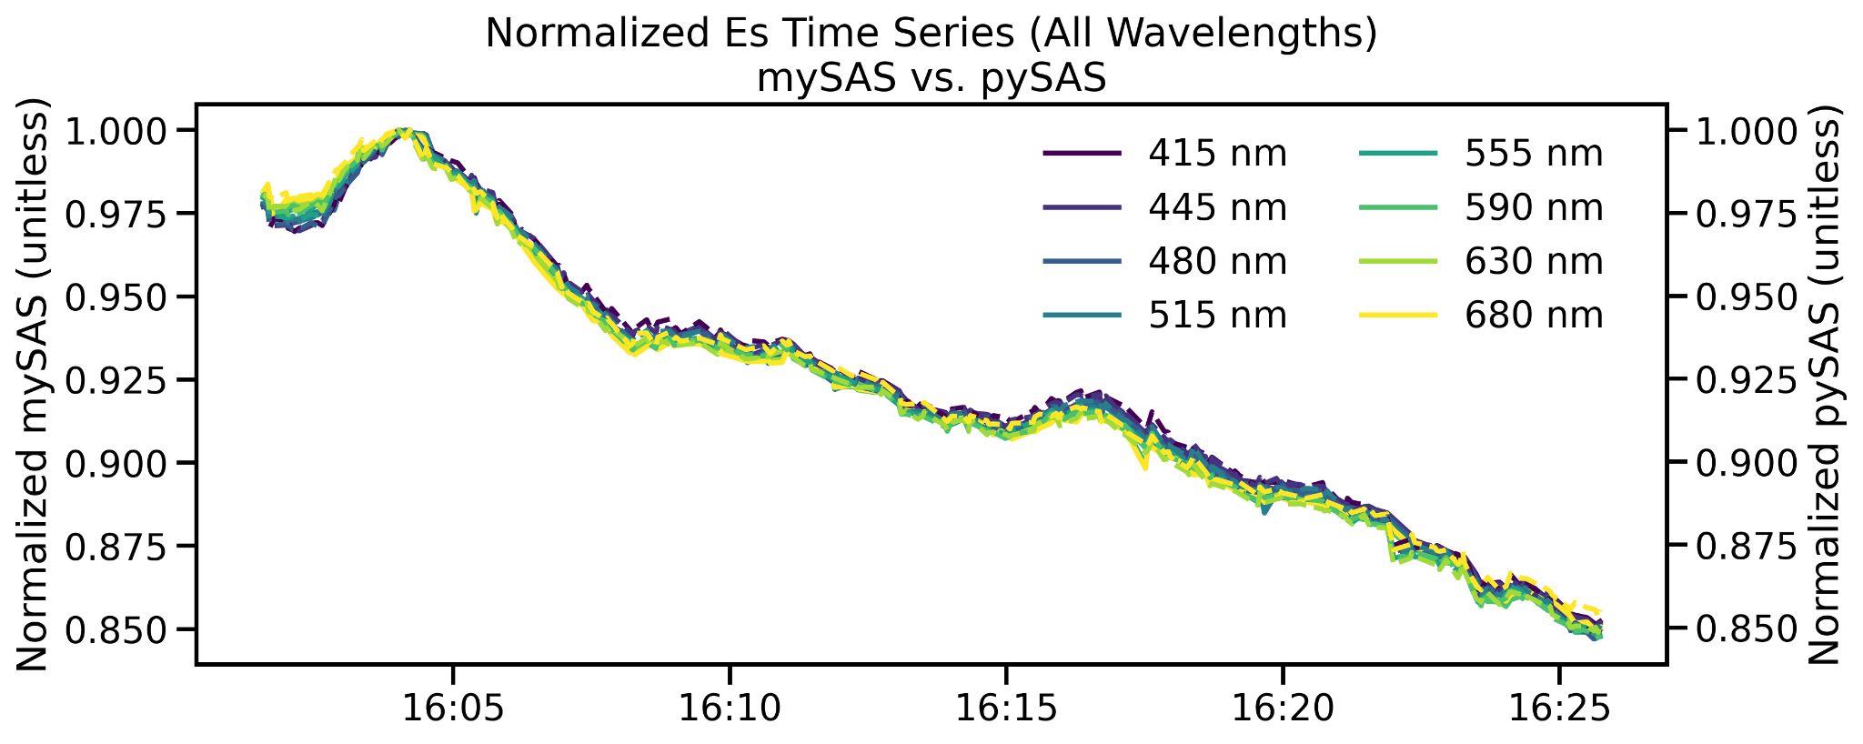
Irradiance Performance - Temporal

Slide 35
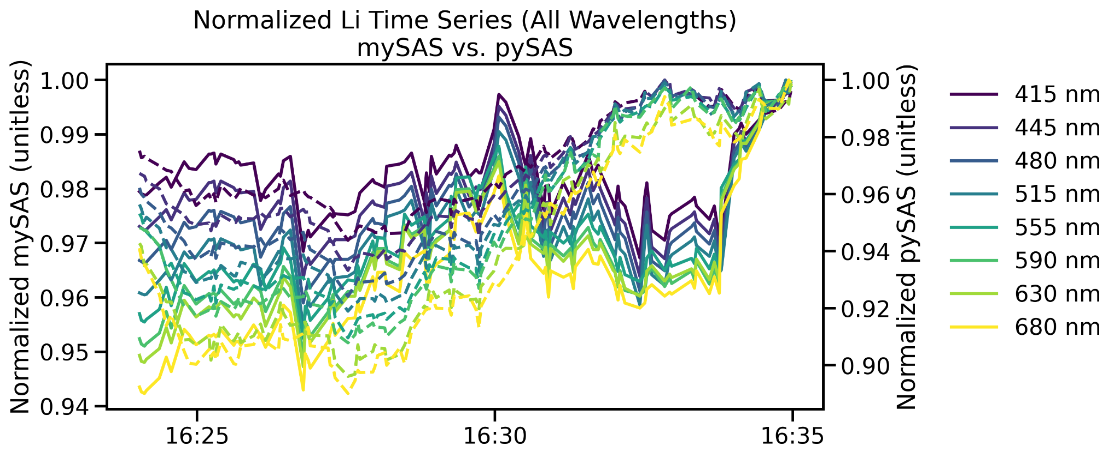
Li Radiance Performance - Temporal

Slide 36
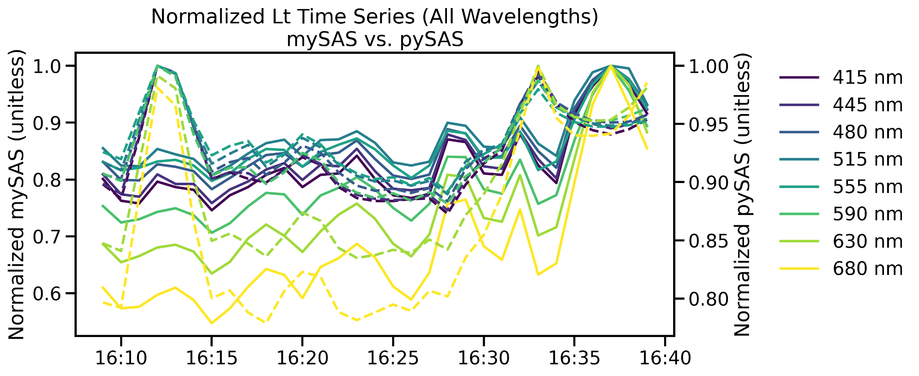
Lu Radiance Performance - Temporal
Notes:
Increase gain for this one - noisy

